Slide 1
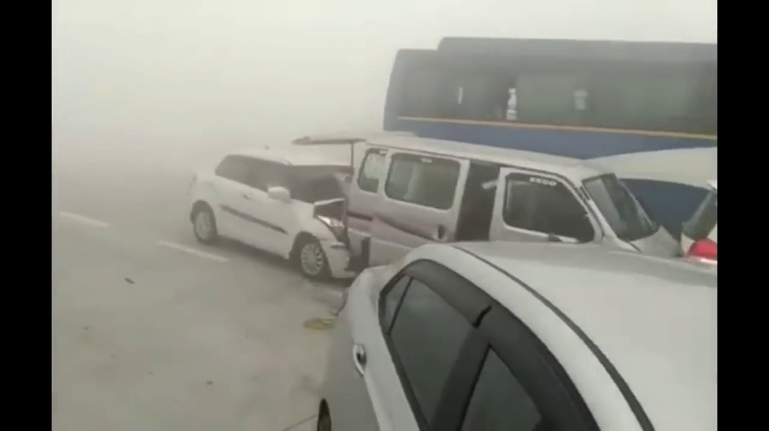
Road Fogg solution

Slide 2
INTRODUCTION
Fog reduces visibility, limits contrast, distorts perception and causes many car accidents each year.
Fog is produced by the suspension of very fine moisture droplets in the air. When light hits these droplets, it scatters and results in a loss of contrast and a dense white background.
As these droplets get smaller, fog gets thicker and makes for roadways that are even more blanketed. As a result, car drivers cannot see very far ahead, and car accidents become an even greater possibility than normal.

Slide 3
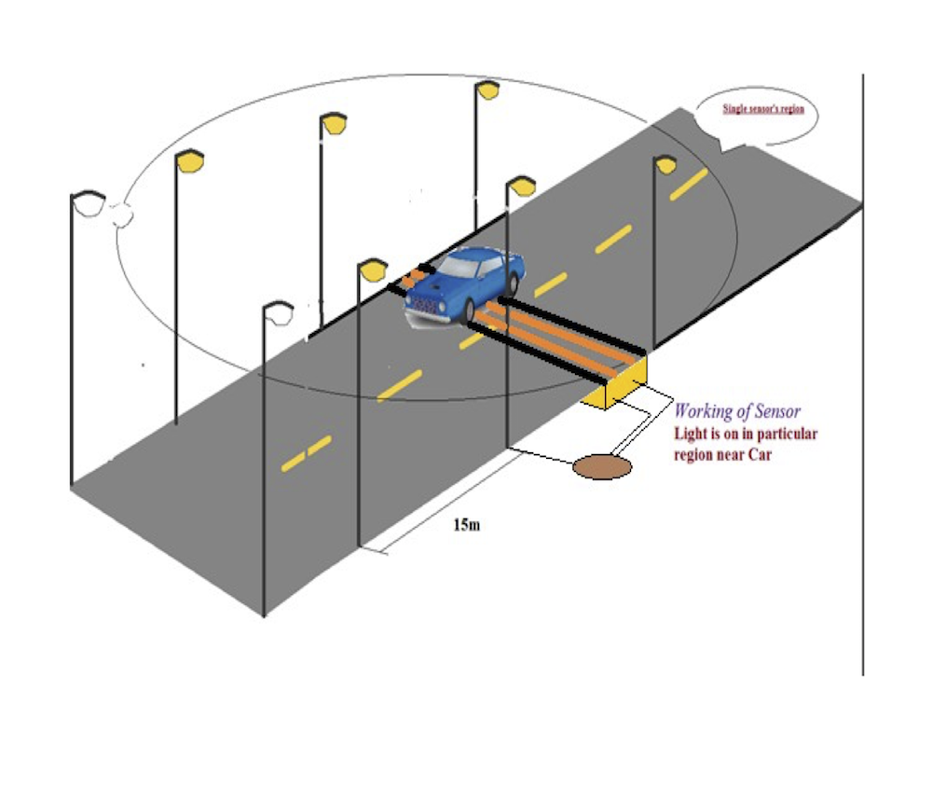
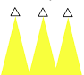
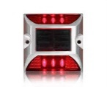
Efficient Model to Enhance Visibility During Fog

Slide 4
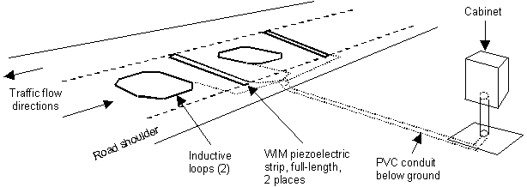
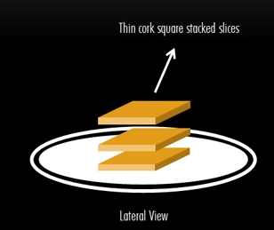
Internal Structure

Slide 5
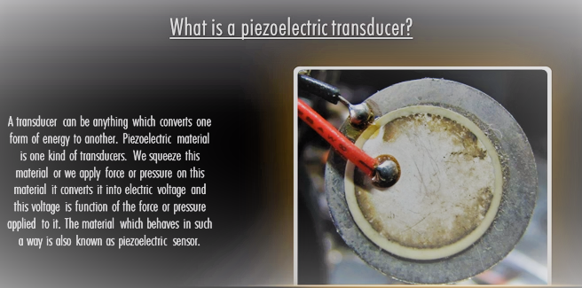
Piezoelectric Transducer

Slide 6
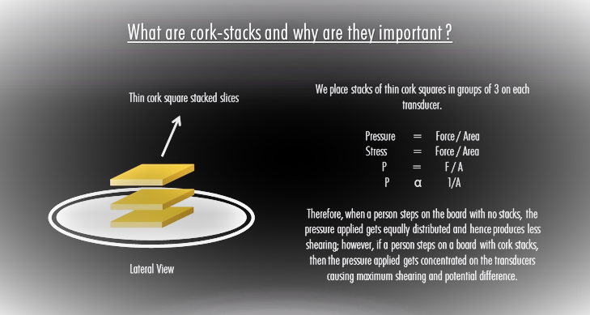

Slide 7
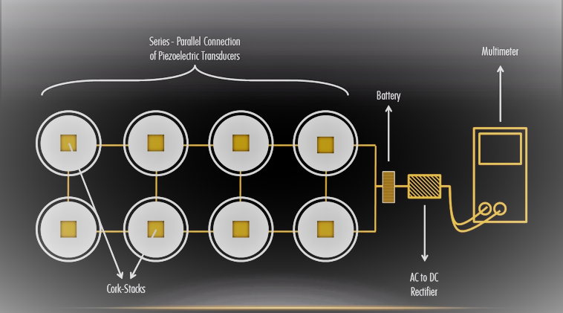
Basic Model

Slide 8
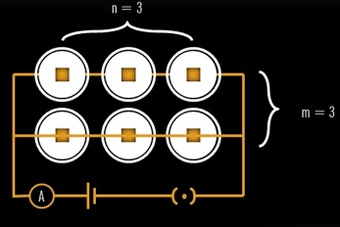
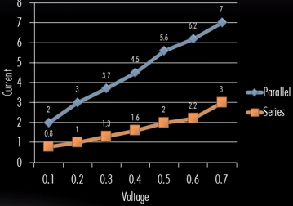
Why Series-Parallel Connection?
We connect the cells in parallel to reduce the total resistance to minimum.
Cells are connected in series parallel as we get good voltage from series connection ,but poor current & in parallel connection we get good current but poor voltage.

Slide 9
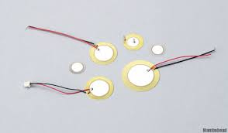

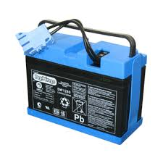
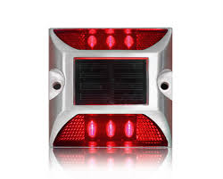
Hardware Required
Piezoelectric sensors
Rectifier
Side LED’s
Rechargeable Source

Slide 10
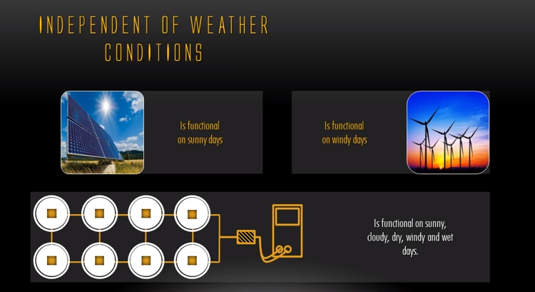
Advantages Of Piezoelectric

Slide 11


Slide 12
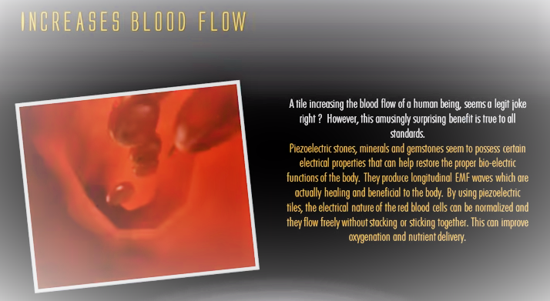

Slide 13
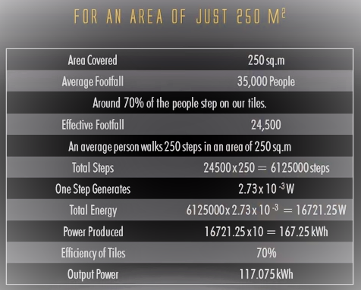
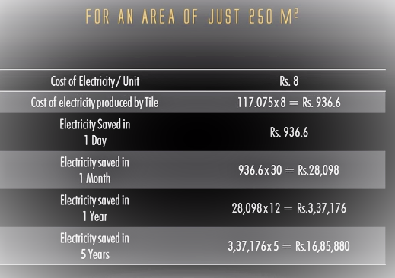
Energy Efficiency
The aim of the current generation must be to provide the people of the world –born & unborn-a future devoid of power cuts and a sustainable environment

Slide 14
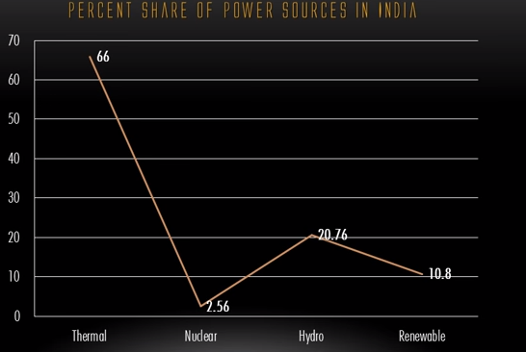
Statistics says that India as a nation is dependent extravagantly on non-renewable sources of energy such as thermal and nuclear energy to provide electricity for its natives.
POWER SOURCES IN INDIA

Slide 15
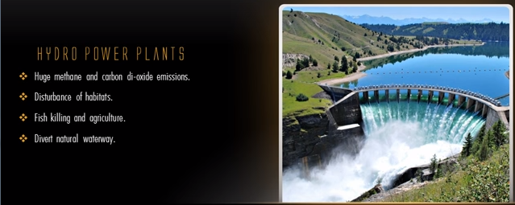
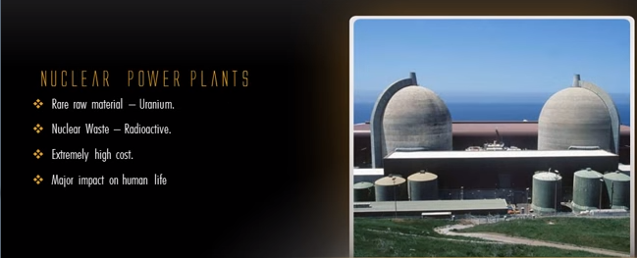

It is crystal clear that non renewable sources of energy definitely do not support, sustainable development.

